Slide 1
Introduction to Quantum Computing
Yongkai Chen

Slide 2
Roadmap
I
II
III
IV
Fundamentals
Grover’s Search
QFT & Phase Estimation
Quantum Parameter Estimation
Qubits, superposition, measurement, gates & circuits, entanglement, mixed states, quantum parallelism
Unstructured search, oracle & diffusion as two reflections, geometry, optimal iterations, amplitude amplification
Phase kickback, quantum Fourier transform, the QPE circuit, accuracy analysis, amplitude estimation, applications
Quantum Fisher information, quantum Cramér–Rao bound, SQL vs. Heisenberg limit, sequential protocols, noise

Slide 3
Part I
Fundamentals of Quantum Computing
From a single qubit to entanglement, measurement, and quantum parallelism

Slide 4



Classical Bit vs. Qubit
Single Classical bit
Single quantum bit (qubit)
or
binary state
quantum state-superposition
the probabilistic nature of the quantum particle
Picture source:
https://medium.com/masters-union-review/real-business-impact-of-quantum-computing-662259c47a05

Slide 5
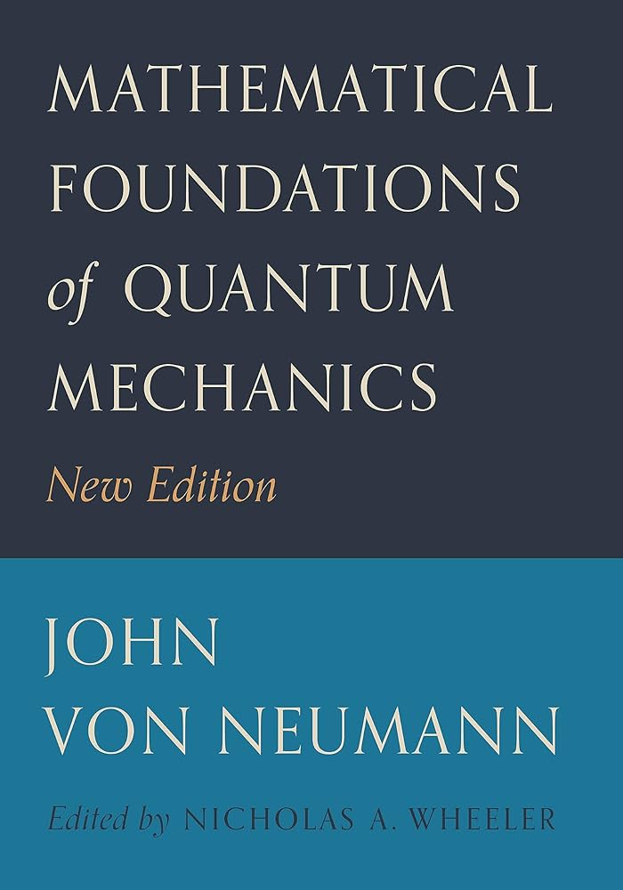
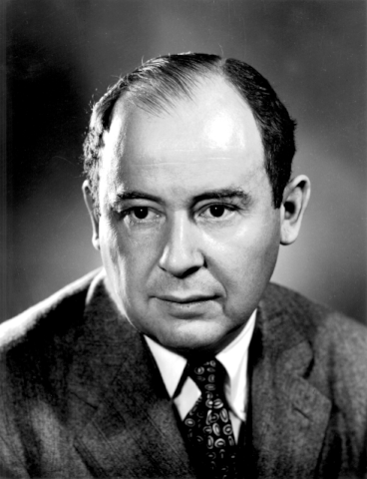
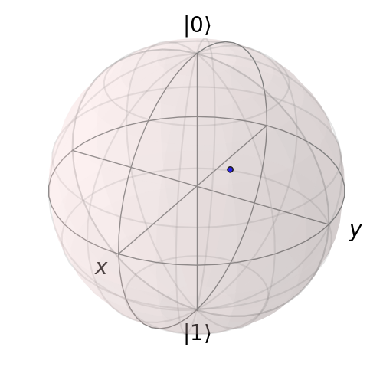

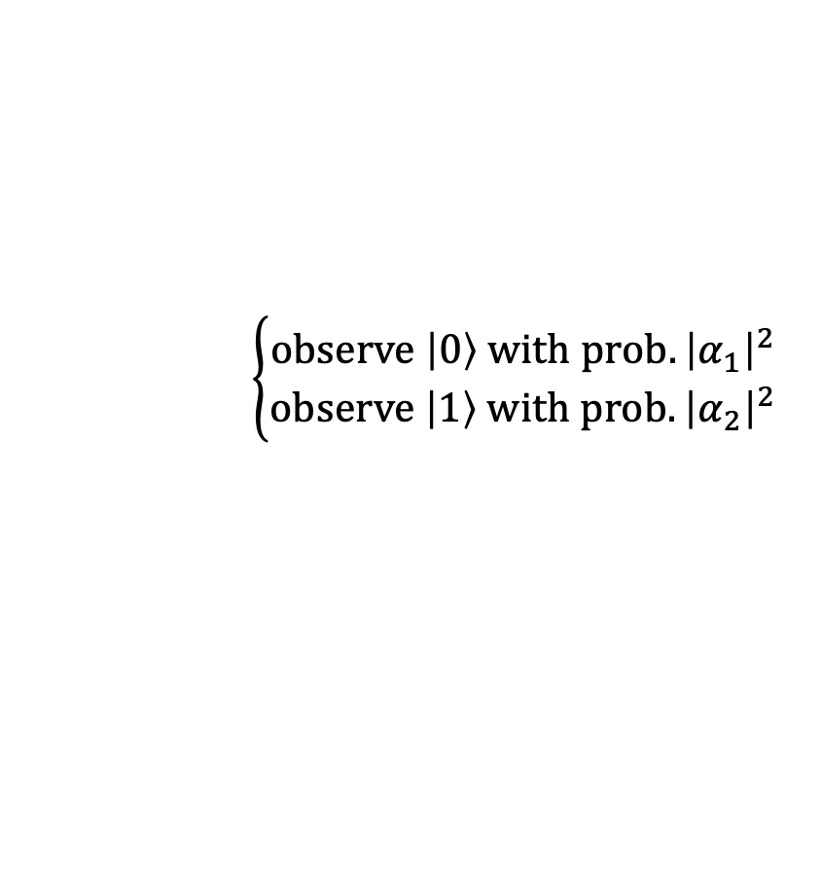

Mathematical Interpretation of Quantum Mechanics
State/superposition is a unit vector
Quantum Hilbert Space for a single qubit, ${ℋ_{1}}_{ }$:
$$\left|ψ\right\rangle =α_{1}\left|0\right\rangle +α_{2}\left|1\right\rangle , α_{1}∈ℝ,α_{2}∈ℂ, and {\left|α_{1}\right|}^{2}+{\left|α_{2}\right|}^{2}=1.$$
z
Bloch sphere
representation
of the superposition
for a single qubit
$$\left|+\right\rangle =\frac{\left|0\right\rangle +|1⟩}{\sqrt{2}}$$
$$\frac{\left|0\right\rangle +i|1⟩}{\sqrt{2}}$$
Measurement/observation is a random trial
collapse
$$\left\{\begin{aligned}observe \left|0\right\rangle with prob. {\left|α_{1}\right|}^{2} \\ observe \left|1\right\rangle with prob. {\left|α_{2}\right|}^{2}\end{aligned}\right.$$
A Bernoulli
random variable
qubit

Slide 6
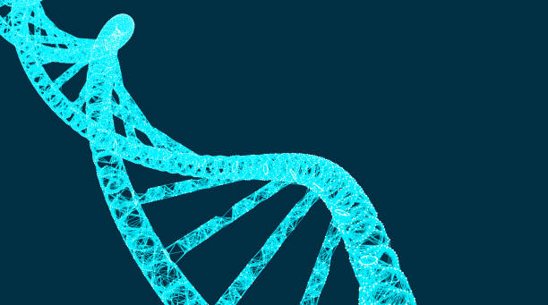
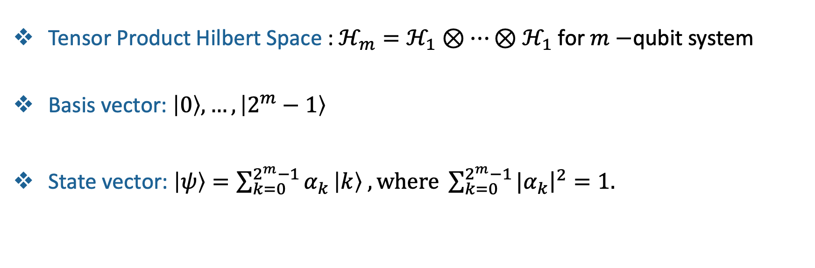

Multiple Qubits
Tensor Product Hilbert Space : $ℋ_{m}=ℋ_{1}⊗⋯⊗ℋ_{1}$ for $m−$qubit system
Basis vector: $\left|0\right\rangle ,…,\left|2^{m}−1\right\rangle$
State vector: $\left|ψ\right\rangle =\sum_{k=0}^{2^{m}−1}{α_{k}}\left|k\right\rangle ,where \sum_{k=0}^{2^{m}−1}{{|α}_{k}{\left.​\right|}^{2}}=1.$
$$m$$
Exponential increase in storage capacity
Example
34 qubits
12.8 x 10⁹ classical bits
Human genome 6.4 million base pairs

Slide 7

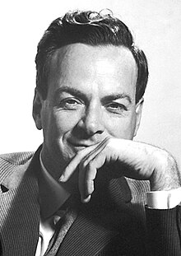
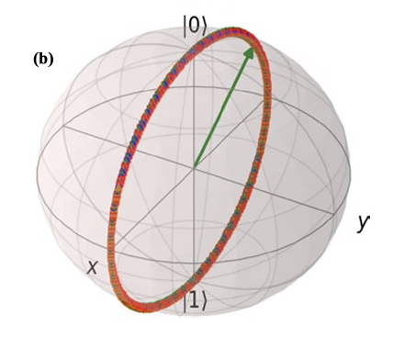
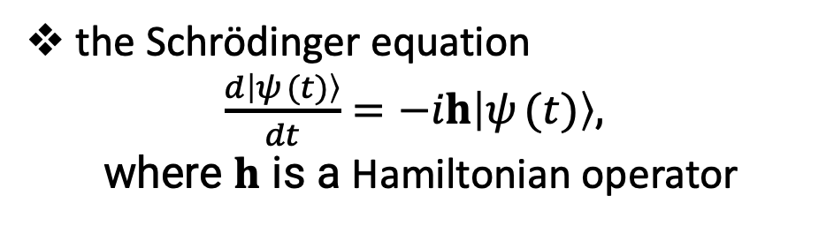

Fundamentals of Quantum Computing
Operations on qubits are rotations
the Schrödinger equation
$\frac{d\left|ψ_{ }(t)\right\rangle }{dt}=−ih\left|ψ_{ }(t)\right\rangle$,
where $h$ is a Hamiltonian operator
Unitary operation $e^{−iht}$
Feynman’s 1981 talk
“Simulating physics with computers.”
Picture source:
Javad Sharif, scientific reports, 2021
5

Slide 8

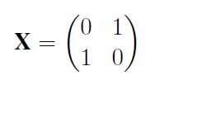

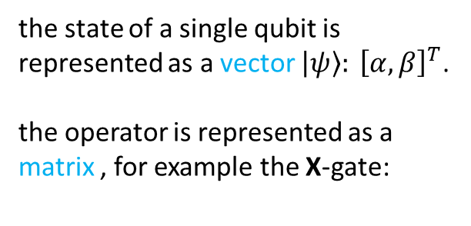

Qubit Operator
Operation means Matrix Multiplication
Example: for a single qubit
$${\left|ψ\right\rangle }^{ }$$
the state of a single qubit is represented as a vector ${\left|ψ\right\rangle : \left[α, β\right]}^{T}$.
the operator is represented as a matrix , for example the X-gate:
Quantum Circuit:
$$X\left|ψ\right\rangle ={\left[β, α\right]}^{T}$$
qubit
X-gate/
operator

Slide 9
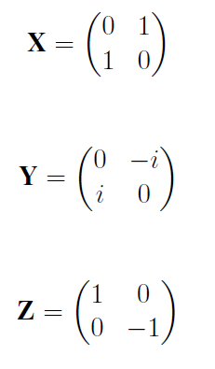
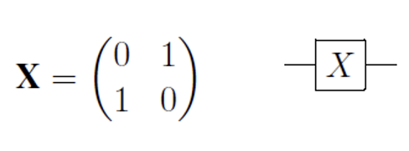
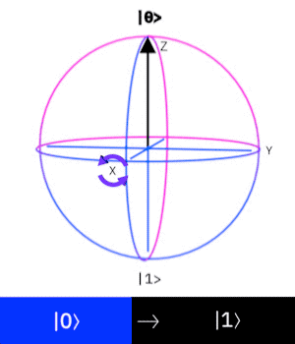
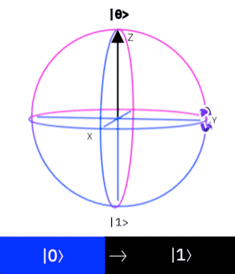
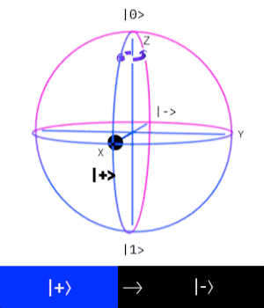
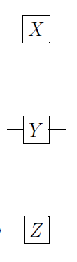

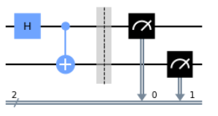
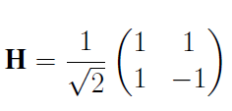
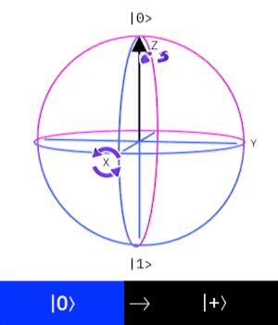
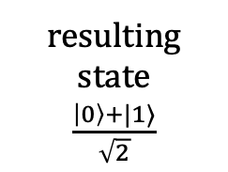
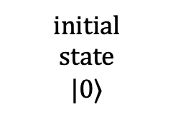
Gate-based quantum computer
Quantum logic gates (universal gate set)
Pauli gates
encode uniform superposition
input
circuit
result
measure
with prob 0.5
with prob 0.5
initial
state
$$|0⟩$$
resulting state
$\frac{\left|0\right\rangle +|1⟩}{\sqrt{2}}$
Hadamard gate

Slide 10
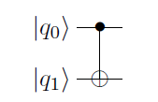
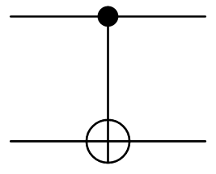
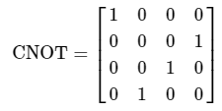

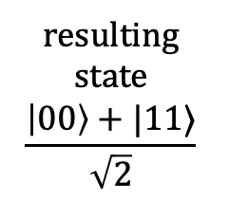
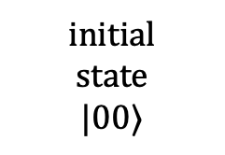
Gate-based quantum computer
Quantum logic gates (universal gate set)
Controlled gates
Create quantum entanglement
input
circuit
result
measure
with prob 0.5
control
$$=|0⟩⟨0|⊗I+|1⟩⟨1|⊗X$$
target
with prob 0.5
resulting
state
$$\frac{\left|00\right\rangle +|11⟩}{\sqrt{2}}$$
initial
state
$$|00⟩$$

Slide 11
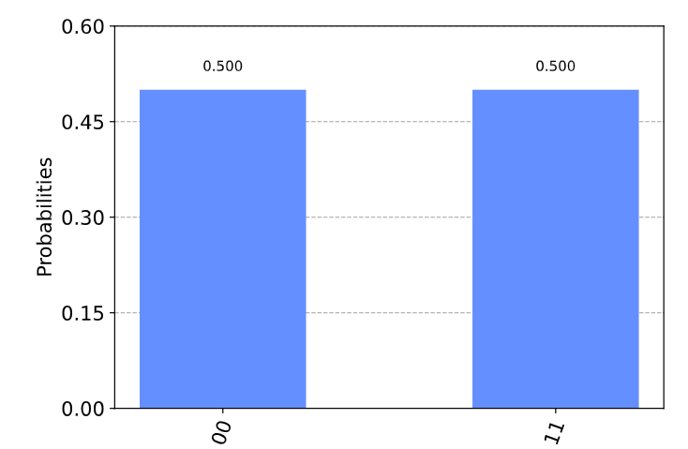
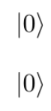
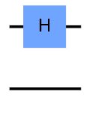
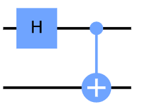


Example: Quantum entanglement
Quantum Circuit
Initial state vector = [1 0 0 0]
Step 1 state vector = [$\frac{1}{\sqrt{2}}$ $\frac{1}{\sqrt{2}}$0 0]
Control qubit
target qubit
Step 2 state vector = [$\frac{1}{\sqrt{2}}$ 0 0 $\frac{1}{\sqrt{2}}$ ]
Collapse/measure

Slide 12
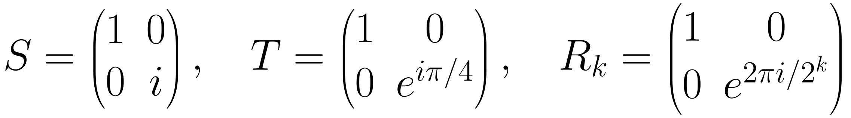
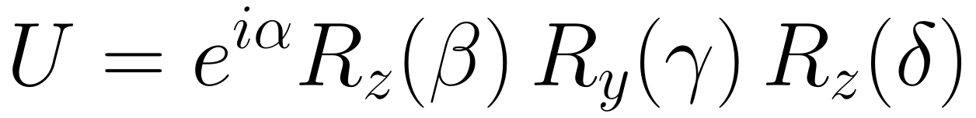
Phase Gates, Rotations, and Universality
More single-qubit gates
Universality
$$S=\left(\begin{matrix}1 & 0 \\ 0 & i\end{matrix}\right), T=\left(\begin{matrix}1 & 0 \\ 0 & e^{iπ/4}\end{matrix}\right), R_{k}=\left(\begin{matrix}1 & 0 \\ 0 & e^{2πi/2^{k}}\end{matrix}\right)$$
{H, T, CNOT} is a universal gate set: any n-qubit unitary can be approximated to arbitrary accuracy.
Solovay–Kitaev: an ε-approximation of a single-qubit gate needs only O(polylog(1/ε)) gates from the set.
Phase gates keep |0⟩ and rotate the phase of |1⟩. R_{k} is the building block of the QFT.
$$R_{z}\left(β\right)=e^{−iβZ/2}, R_{y}\left(γ\right)=e^{−iγY/2}, R_{x}\left(α\right)=e^{−iαX/2}$$
Circuit model in one line
initial state |0⟩^{⊗n} → sequence of gates (a big unitary U = U_{L} ⋯ U₂ U₁) → measurement.
Cost measures: number of qubits (space), circuit depth / gate count (time), and number of oracle queries (query complexity).
Any single-qubit unitary is a product of rotations:
$$U=e^{iα}R_{z}\left(β\right) R_{y}\left(γ\right) R_{z}\left(δ\right)$$
Controlled-U
$$C\left(U\right)=|0⟩⟨0|⊗I+|1⟩⟨1|⊗U$$
Two facts that shape every algorithm
Gates are unitary, hence reversible; measurement is the only irreversible step.
No-cloning: an unknown quantum state cannot be copied, so information must be extracted by clever measurement.
Apply U to the target only if the control is |1⟩ (CNOT = C(X)). Controlled powers U^{m} (m = 1, 2, 4, …) drive phase estimation.

Slide 13
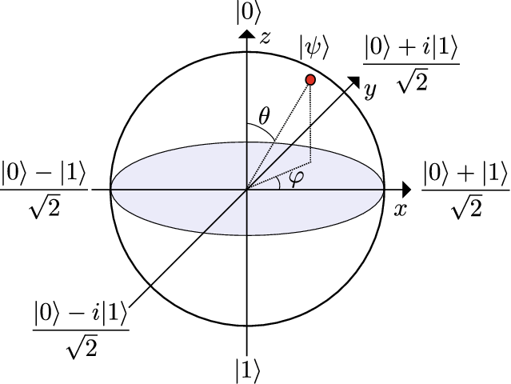
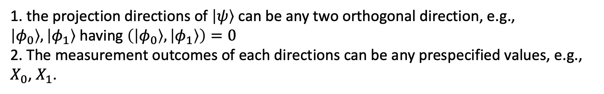
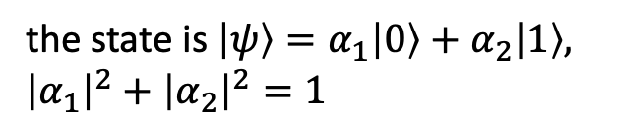
Quantum Measurement
Intuitive interpretation of Quantum Measurement
a “naïve” quantum measurement
Our measurement is directly taken on $\left|ψ\right\rangle .$ Then, the probability of observing 0 is ${\left|α_{1}\right|}^{2}$ and the probability of observing 1 is ${\left|α_{2}\right|}^{2}$
Equivalent with projecting $\left|ψ\right\rangle$ to the states $\left|0\right\rangle$ , $\left|1\right\rangle$. The probabilities of observing corresponding outcomes are the square length of the projected vector
Two natural generalizations
the state is $\left|ψ\right\rangle =α_{1}\left|0\right\rangle +α_{2}\left|1\right\rangle ,$
${\left|α_{1}\right|}^{2}+{\left|α_{2}\right|}^{2}=1$
1. the projection directions of $\left|ψ\right\rangle$ can be any two orthogonal direction, e.g., $\left|φ_{0}\right\rangle ,\left|φ_{1}\right\rangle$having $\left(\left|φ_{0}\right\rangle ,\left|φ_{1}\right\rangle \right)=0$
2. The measurement outcomes of each directions can be any prespecified values, e.g., $X_{0}$, $X_{1}$.

Slide 14
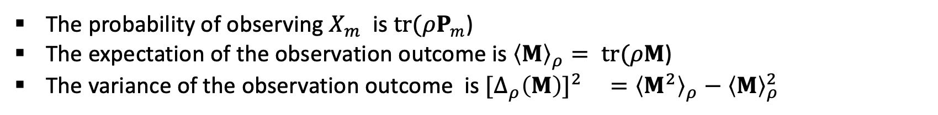

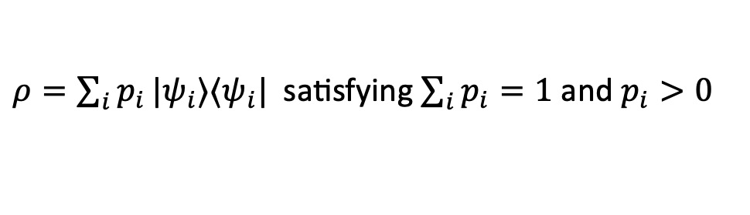

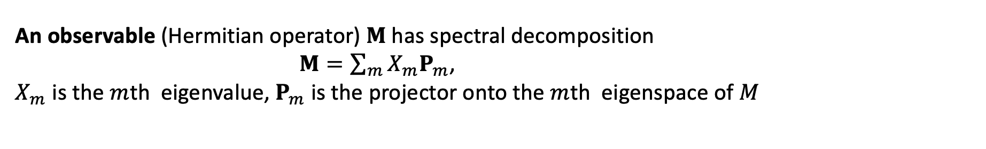
Quantum Measurement
Rigorous formalization of Quantum Measurement
State/density operator
$ρ=\sum_{i}{p_{i}}|ψ_{i}⟩⟨ψ_{i}|$ satisfying $\sum_{i}{p_{i}}=1$ and $p_{i}>0$
Pure state $ρ=|ψ⟩⟨ψ|$
$$tr(ρ)=1$$
An observable (Hermitian operator) $M$has spectral decomposition
$M=\sum_{m}{X_{m}P_{m}}$,
$X_{m}$ is the $m$th eigenvalue, $P_{m}$ is the projector onto the $m$th eigenspace of $M$
$X_{m}$ denotes the value of the $m$th measurement outcome may occur in the experiment
measure the observable $M$ using the system with the density operator $ρ$
The probability of observing $X_{m}$ is $tr(ρP_{m}$)
The expectation of the observation outcome is ${\left\langle M\right\rangle }_{ρ}= tr(ρM$)
The variance of the observation outcome is ${{[Δ}_{ρ}{\left(M\right)]}^{2} }_{ }={\left\langle M^{2}\right\rangle }_{ρ}−{\left\langle M\right\rangle }_{ρ}^{2}$

Slide 15
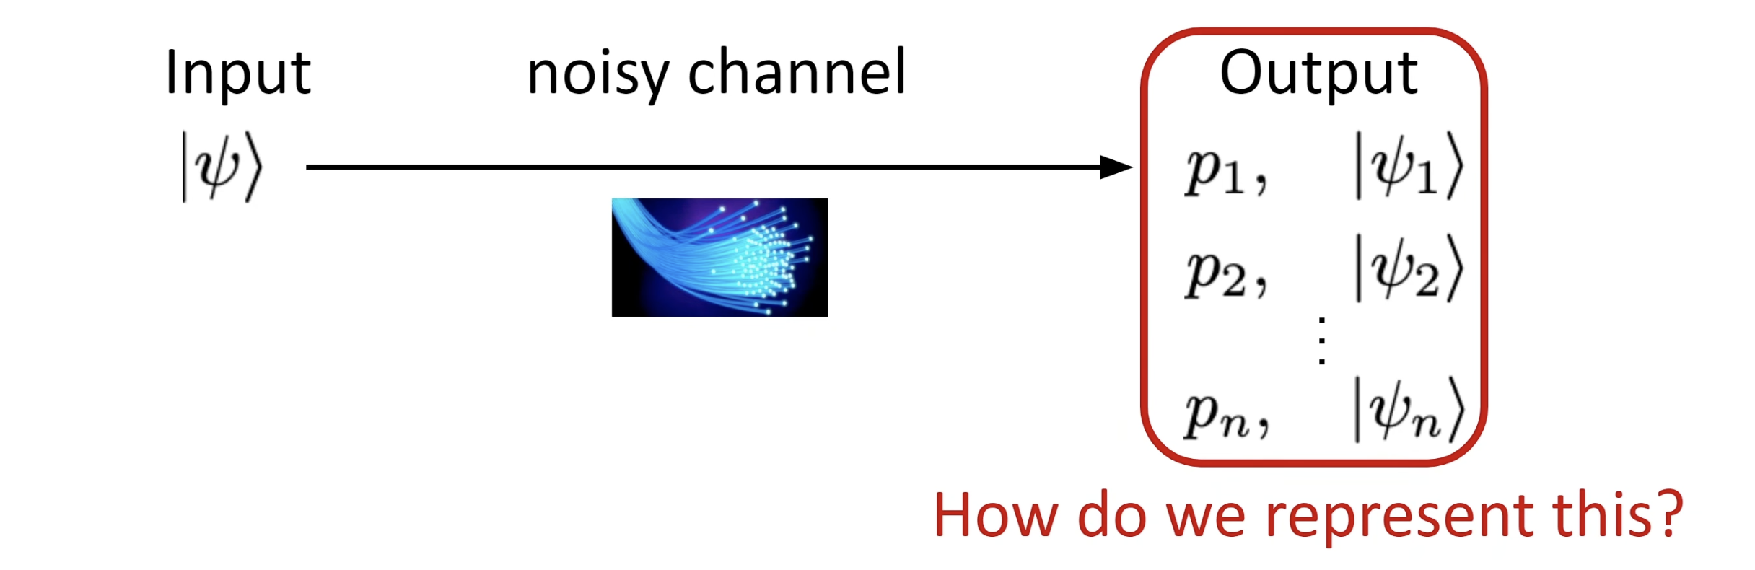
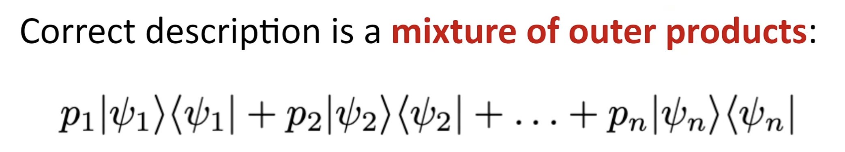

Mixed State
Cannot be represented with superposition!
$$ρ=$$

Slide 16

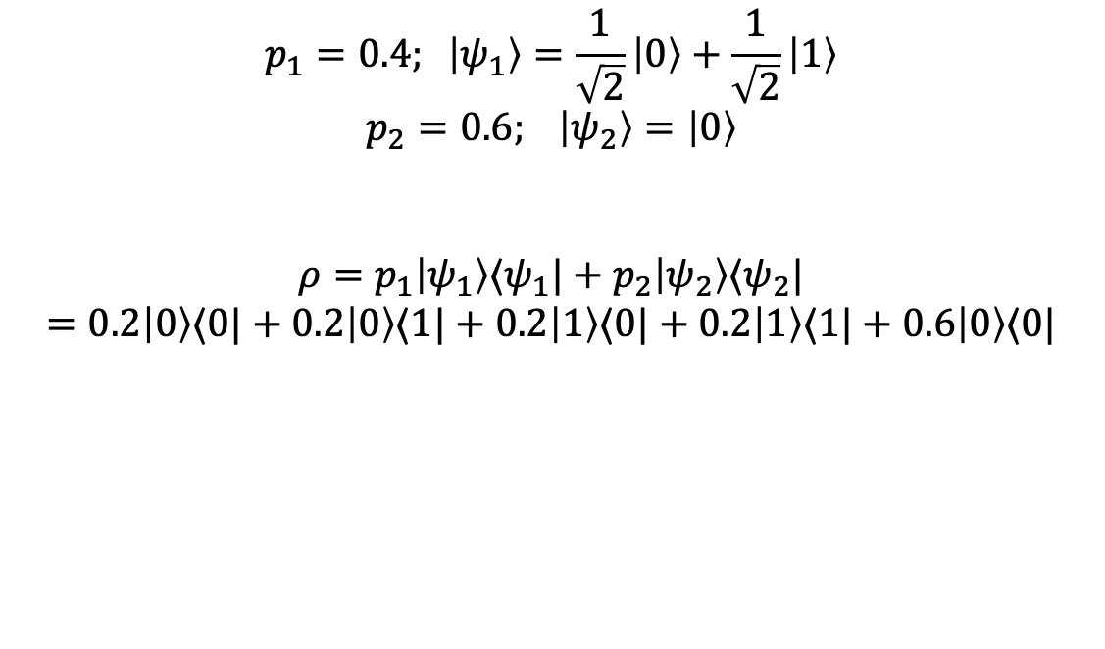


Example of mixed state
$$p_{1}=0.4; \left|ψ_{1}\right\rangle =\frac{1}{\sqrt{2}}\left|0\right\rangle +\frac{1}{\sqrt{2}}\left|1\right\rangle$$
$$p_{2}=0.6; \left|ψ_{2}\right\rangle =\left|0\right\rangle$$
$$ρ=p_{1}\left|ψ_{1}\right\rangle ⟨ψ_{1}|+p_{2}\left|ψ_{2}\right\rangle ⟨ψ_{2}|$$
$$=0.2\left|0\right\rangle ⟨0|+0.2\left|0\right\rangle ⟨1|+0.2\left|1\right\rangle ⟨0|+0.2\left|1\right\rangle ⟨1|+0.6\left|0\right\rangle ⟨0|$$
$$⟨1|$$
$$\left|0\right\rangle$$
$$\left|0\right\rangle$$
$$\left[\begin{matrix}0.8 & 0.2 \\ 0.2 & 0.2\end{matrix}\right]$$
$$\left|1\right\rangle$$
density matrix

Slide 17
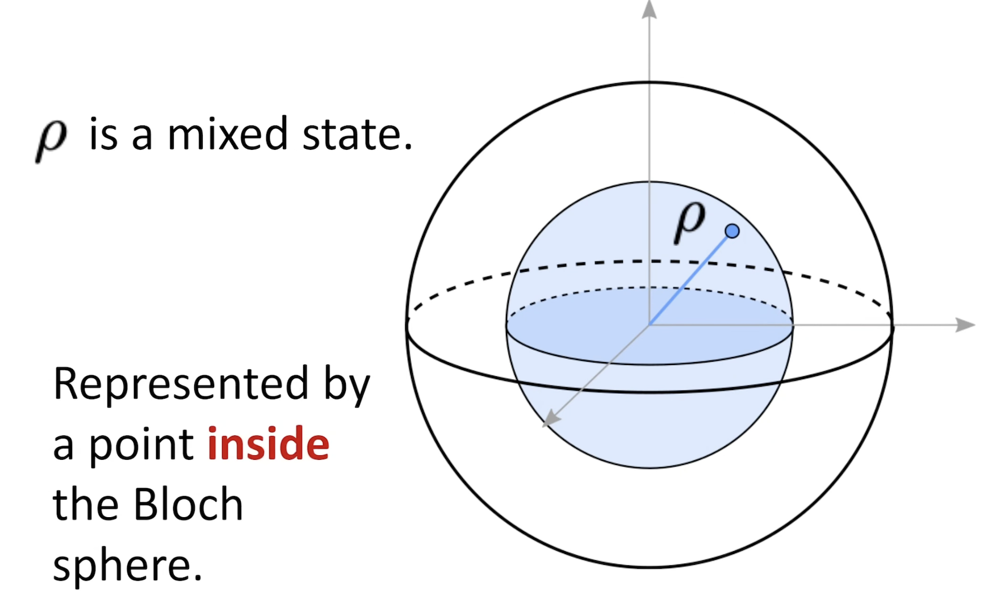
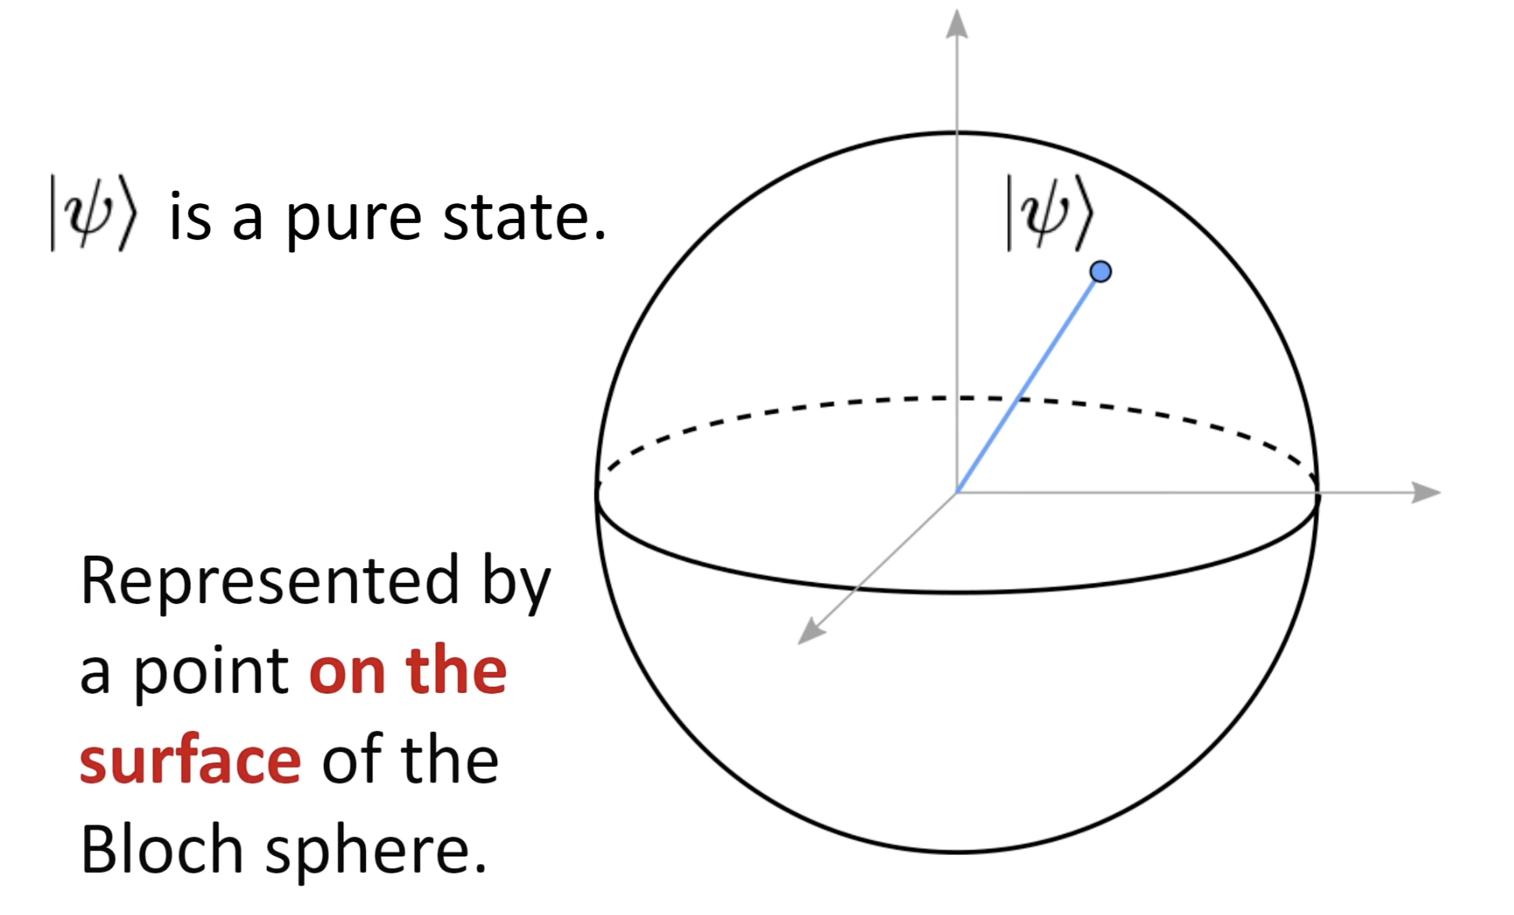
Mixed State and Pure state

Slide 18
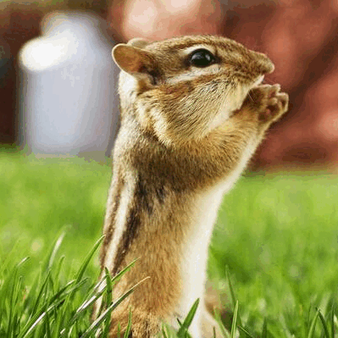
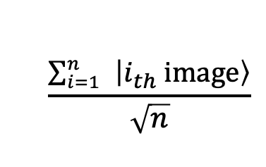
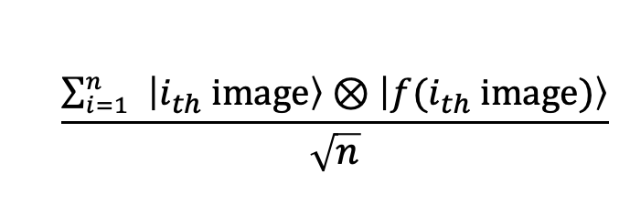
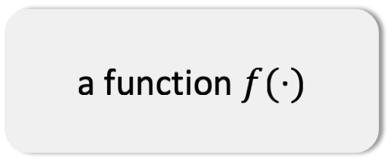
Rationale-Quantum Parallelism
A “quantum image”
What happens
$$\frac{\sum_{i=1}^{n}{ }\left|i_{th} image\right\rangle }{\sqrt{n}}$$
Amazing Property !
ask the quantum computer once, and
you “obtain” all the answers
a function $f(⋅)$
Is this an image of a dog?
$$\frac{\sum_{i=1}^{n}{ }\left|i_{th} image\right\rangle ⊗\left|f{(i}_{th} image)\right\rangle }{\sqrt{n}}$$
Yes “and” No “and” Yes “and” ….

Slide 19
Rationale-Quantum Parallelism
A “quantum image”
What happens
$$\frac{\sum_{i=1}^{n}{ }\left|i_{th} image\right\rangle }{\sqrt{n}}$$
Bad news !!
Preparing the input is time consuming.
When you want to know the answer
for each image in the real world,
you measure the state,
it can only randomly tell you one of
the answers !
a function $f(⋅)$
Is this an image of a dog?
$$\frac{\sum_{i=1}^{n}{ }\left|i_{th} image\right\rangle ⊗\left|f{(i}_{th} image)\right\rangle }{\sqrt{n}}$$
Yes “and” No “and” Yes “and” ….

Slide 20
From Parallelism to Algorithms: Interference
1 Superpose
H^{⊗n} creates all 2^{n} inputs at once
2 Compute
one call of U_{f} evaluates f on every input
3 Interfere
reflections (Grover) or QFT† (QPE) cancel wrong answers
4 Measure
the answer now carries most of the probability
Amplitudes are signed / complex numbers, so they can cancel (destructive interference) or reinforce (constructive interference). Parallelism alone gives a random answer; interference is what turns it into a useful one.
Task | Classical | Quantum | Speed-up
Unstructured search over D items | Θ(D) queries | Θ(√D) (Grover) | quadratic
Estimate a mean / probability to ±ε | O(1/ε²) samples | O(1/ε) (amplitude estimation) | quadratic
Eigenphase / period finding (e.g. factoring) | super-polynomial (best known) | polynomial (QPE, Shor) | exponential
Parts II and III develop the two archetypal interference patterns: Grover’s rotations and the quantum Fourier transform.

Slide 21

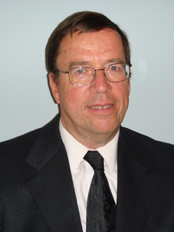
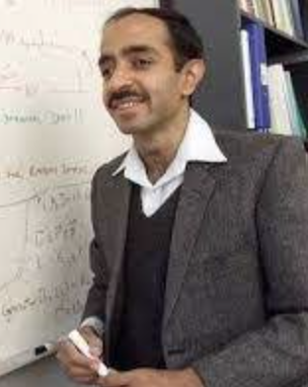
Development of Quantum Algorithm
Variational
quantum
Algorithm,
exponential
speed-up
exponential
speed-up
Shor’s algorithm
quantum neural network,
quadratic
speed-up
Quantum Monte Carlo
Quantum
amplitude
estimation
&
Quantum
counting
Quantum sampling
Searching
unsorted
database
quantum SVM,
Quantum random walk
Phase
estimation
quantum kernel regression,
Quantum annealing
Quantum
Fourier
transform
HHL algorithm
&
Quantum PCA
quantum
reinforcement learning,
Quantum
simulation
Quantum
Machine learning
Grover’s
algorithm
...
Richard Feynman
1981
Don Coppersmith
1994
Lov Grover
1996
2017 - present

Slide 22
Part II
Grover’s Search Algorithm
Finding a needle in an unstructured haystack with √D queries

Slide 23

The Unstructured Search Problem
A list of D = 2^{n} items, labelled x ∈ {0, 1, …, D − 1}.
A black-box oracle recognizes the solution: f(x) = 1 if x = k (the marked item), 0 otherwise.
No structure to exploit: the only way to learn about k is to query f.
Classical: each query checks one item ⇒ D/2 queries on average, Θ(D) in the worst case.
Quantum: query f on a superposition; Grover (1996) finds k with O(√D) queries.
This is optimal: every quantum algorithm needs Ω(√D) queries (Bennett–Bernstein–Brassard–Vazirani 1997).
Example: D = 2³⁰ ≈ 1.07 × 10⁹
≈ 5.4 × 10⁸
expected classical queries (D/2)
≈ 25,736
The oracle as a reversible quantum gate
Grover queries (π/4)·√D
$$U_{f}|x⟩|y⟩=|x⟩|y⊕f\left(x\right)⟩$$
The gap widens with D: the speed-up is quadratic, not exponential.
Classical logic is made reversible by keeping the input; on a superposition of x, one call to U_{f} acts on all items simultaneously.

Slide 24





Step 0: Uniform Superposition over All Items
$$0,0,…,0$$
$$1,0,…,0$$
$$0,1,…,0$$
$$1,1,…,1$$
measurement
$n$ qubits
$$\left|ψ_{0}\right\rangle =(\frac{1}{\sqrt{2}}\left|0\right\rangle +\frac{1}{\sqrt{2}}|1⟩)⊗…⊗(\frac{1}{\sqrt{2}}\left|0\right\rangle +\frac{1}{\sqrt{2}}|1⟩)=\frac{1}{\sqrt{2^{n}}} \sum_{i=0}^{2^{n}−1}{|i⟩}$$
uniform
superposition of
all D = 2ⁿ items
$$n$$

Slide 25



Two-Dimensional Picture of the Initial State
Suppose |k⟩ is the marked item (the solution)
Let D=$2^{n}$
$$|k⟩=0⋅\left|1\right\rangle +⋯+1⋅\left|k\right\rangle +⋯+0⋅|D⟩$$
$$|ζ⟩=\frac{1}{\sqrt{D−1}}\left|1\right\rangle +⋯0⋅\left|k\right\rangle +⋯\frac{1}{\sqrt{D−1}}|D⟩$$
$$|k⟩⊥|ζ⟩$$

Slide 26

Geometry interpretation

Slide 27


Grover’s Two Reflections
Oracle F (reflection about |ζ⟩)
Diffusion G (reflection about |ψ₀⟩)
$$F=I−2|k⟩⟨k|, F|x⟩={\left(−1\right)}^{f\left(x\right)}|x⟩$$
$$G=2|ψ_{0}⟩⟨ψ_{0}|−I=H^{⊗n}\left(2|0⟩⟨0|−I\right)H^{⊗n}$$
Flips the sign of the marked amplitude only. Implemented with one call of U_{f} via phase kickback:
“Inversion about the mean”: each amplitude is reflected about the average amplitude ᾱ.
$$U_{f}|x⟩|−⟩={\left(−1\right)}^{f\left(x\right)}|x⟩|−⟩, |−⟩=1/{\sqrt{2}}\left(|0⟩−|1⟩\right)$$
$$G\sum_{x}^{​}{α_{x}}|x⟩=\sum_{x}^{​}{\left(2\overset{‾}{α}−α_{x}\right)}|x⟩, \overset{‾}{α}=\frac{1}{D}\sum_{x}^{​}{α_{x}}$$
Needs no knowledge of k: it only uses H gates and a conditional phase on |0…0⟩.
After F made the marked amplitude negative, G pushes it far above the mean.
Grover iterate GF: two reflections = one rotation by 2θ in the plane span{|k⟩, |ζ⟩}, where sin θ = 1/√D.

Slide 28

Grover Iteration: The Geometric View
Goal: measure $|k⟩$ with higher probability

Slide 29

Grover Iteration: The Geometric View
One step
Goal: measure $|k⟩$ with higher probability

Slide 30


Grover’s Algorithm: How Many Iterations?
At the jth step, away from $|ζ⟩$
$$j≈O(\sqrt{D})$$

Slide 31

Success Probability and “Overshooting”
$${\left(GF\right)}^{j}|ψ_{0}⟩=sin\left(\left(2j+1\right)θ\right)|k⟩+cos\left(\left(2j+1\right)θ\right)|ζ⟩$$
$$P_{j}=Pr\left(\text{measure }k\right)=\sin^{2}\left(\left(2j+1\right)θ\right), sinθ=\frac{1}{\sqrt{D}}$$
Stop at j* = round(π/(4θ) − 1/2) ≈ (π/4)√D.
Then the final angle is within θ of π/2, so P_{j*} ≥ cos²θ = 1 − 1/D.
Iterating too long rotates past |k⟩: P_{j} is periodic in j. Unlike classical search, more work can hurt.
That periodicity encodes θ (hence the number of solutions) in a phase — exactly what phase estimation reads out (quantum counting, Part III).

Slide 32

Worked Example: n = 2 Qubits, Marked Item k = |11⟩
D = 4 ⇒ sin θ = 1/2, θ = π/6. One iteration rotates the state to angle 3θ = π/2: k is found with probability 1.
mean amplitude after F: ᾱ = 1/4

Slide 33



Beyond the Basic Algorithm
Multiple solutions
Unknown number of solutions
$$sinθ=\sqrt{M/D}, j^{∗}≈\frac{π}{4}\sqrt{D/M}$$
$$O\left(\sqrt{D/M}\right) \text{expected queries}$$
With M marked items the same geometry applies; the starting angle is larger, so fewer iterations are needed.
Choose the iteration count at random from a growing range (Boyer–Brassard–Høyer–Tapp 1998), or first estimate M by quantum counting.
Optimality
Amplitude amplification
$$Ω\left(\sqrt{D}\right) \text{queries are necessary}$$
$$Q=−𝒜S_{0}𝒜^{−1}S_{χ}, O\left(1/\sqrt{a}\right) \text{calls}$$
No quantum algorithm can do better (BBBV 1997); Grover’s iteration count is exactly optimal (Zalka 1999).
Any algorithm 𝒜 that succeeds with probability a can be boosted with O(1/√a) uses of 𝒜 instead of O(1/a) classical repetitions (Brassard–Høyer–Mosca–Tapp 2002).

Slide 34
Part III
QFT & Quantum Phase Estimation
Turning an unknown phase into a measurable bit string

Slide 35
The Phase Estimation Problem
Problem
Application | Unitary U | Phase φ encodes
Shor / order finding | U|x⟩ = |ax mod N⟩ | s/r, r = order of a
Amplitude estimation, counting | Grover iterate Q | ±θ/π, a = sin²θ
HHL linear systems, quantum PCA | exp(iAt), exp(iρt) | eigenvalues of A, ρ
Quantum chemistry | exp(−iHt) | energy levels of H
$$U|u⟩=e^{2πiφ}|u⟩, φ∈[0,1)$$
Given: an eigenstate |u⟩ and the ability to apply controlled powers U^{m}, m = 2^{j}.
Goal: estimate the eigenphase φ to T bits of precision.
Eigenvalues of unitaries are on the unit circle, so the phase φ carries all the information.
One subroutine, many algorithms
Every row on the right is “find an eigenvalue of a cleverly chosen U”.
Precision 2^{−T} costs about 2^{T} applications of U — the source of both the quadratic (estimation) and exponential (factoring) speed-ups.

Slide 36



Phase Kickback
|u⟩ is an eigenstate, so it is unchanged: U^{m}|u⟩ = e^{2πimφ}|u⟩ with m = 2^{j}.
The phase is “kicked back” onto the control qubit, where it becomes a relative phase we can interfere with.
Same trick as Grover’s phase oracle (target |−⟩, eigenvalue −1).
$$\frac{|0⟩+|1⟩}{\sqrt{2}}⊗|u⟩ \overset{ C\left(U^{2^{j}}\right) }{→} \frac{|0⟩+e^{2πi 2^{j}φ}|1⟩}{\sqrt{2}}⊗|u⟩$$
With T auxiliary qubits, qubit j controls U^{m} with m = 2^{T−j}:
$$⨂_{j=1}^{T}\frac{|0⟩+e^{2πi 2^{T−j}φ}|1⟩}{\sqrt{2}}=\frac{1}{\sqrt{2^{T}}}\sum_{l=0}^{2^{T}−1}{e^{2πiφl}}|l⟩$$
a “quantum Fourier series” in φ — undo it with the inverse QFT

Slide 37





Phase Estimation
given a unitary operator $U=e^{2πiρ}$
a quantum system (register) in a state $|ψ⟩$(one of an eigenvector of $ρ$)
calculate the eigenvalue of $|ψ⟩$ (denote as $e^{2πiθ}$)
Goal:
Example when t=1
$$(\frac{1}{\sqrt{2}}\left|0\right\rangle +\frac{1}{\sqrt{2}}\left|1\right\rangle )⨂|ψ⟩$$
Auxiliary qubits
Control $U$ operator
$\frac{1}{\sqrt{2}}\left|0\right\rangle ⨂|ψ⟩+\frac{1}{\sqrt{2}}\left|1\right\rangle$ $⨂U|ψ⟩$ =
$\frac{1}{\sqrt{2}}\left|0\right\rangle ⨂|ψ⟩+\frac{1}{\sqrt{2}}\left|1\right\rangle$ $⨂e^{2πiθ}|ψ⟩$=
$\frac{1}{\sqrt{2}}\left|0\right\rangle ⨂|ψ⟩+\frac{1}{\sqrt{2}}e^{2πiθ}\left|1\right\rangle$ $⨂|ψ⟩$=
$(\frac{1}{\sqrt{2}}\left|0\right\rangle +\frac{1}{\sqrt{2}}e^{2πiθ}\left|1\right\rangle )$ $⨂$ $|ψ⟩$

Slide 38
The Quantum Fourier Transform (QFT)
$$QFT|x⟩=\frac{1}{\sqrt{2^{n}}}\sum_{y=0}^{2^{n}−1}{e^{2πi xy/2^{n}}}|y⟩, x∈\{0,…,2^{n}−1\}$$
The discrete Fourier transform applied to the 2^{n} amplitudes of a state; it is unitary, so QFT† = QFT⁻¹ exists as a circuit.
Product representation (binary fraction 0.x_{l}…x_{n} = x_{l}/2 + x_{l+1}/4 + ⋯)
$$QFT|x_{1}x_{2}⋯x_{n}⟩=\frac{\left(|0⟩+e^{2πi 0.x_{n}}|1⟩\right)⊗\left(|0⟩+e^{2πi 0.x_{n−1}x_{n}}|1⟩\right)⊗⋯⊗\left(|0⟩+e^{2πi 0.x_{1}x_{2}⋯x_{n}}|1⟩\right)}{2^{n/2}}$$
Why this is the key to QPE
If φ = 0.x₁x₂…x_{T} exactly, then 2^{T−j}φ ≡ 0.x_{T−j+1}…x_{T} (mod 1), so the phase-kickback state is exactly QFT|x₁…x_{T}⟩.
Applying QFT† returns |x₁…x_{T}⟩: the bits of φ.
Caveat for data analysts
The QFT transforms amplitudes, which we cannot read directly. It does not replace the classical FFT on a data vector; it is useful inside algorithms whose output is a few measured bits.

Slide 39


QFT Circuit and Cost
$$R_{k}=\left(\begin{matrix}1 & 0 \\ 0 & e^{2πi/2^{k}}\end{matrix}\right)$$
The H on qubit l encodes the binary digit x_{l} as a phase; each controlled-R_{k} adds the next digit.
Swaps at the end reverse the qubit order.
n Hadamards + n(n−1)/2 controlled rotations: O(n²) gates.
Classical FFT on 2^{n} numbers: O(n·2^{n}) operations.
Approximate QFT (drop R_{k} with k ≳ log n): O(n log n) gates with negligible error.
Inverse QFT
Run the circuit backwards with conjugated rotations R_{k}† (and reversed order).
QFT† maps the Fourier series 2^{−T/2} Σ_{l} e^{2πi φ l}|l⟩ to (a state concentrated on) |2^{T} φ⟩.

Slide 40





Quantum Phase Estimation: The Full Circuit
①
$$|0⟩^{⊗T}|u⟩$$
②
$$\frac{1}{\sqrt{2^{T}}}\sum_{l=0}^{2^{T}−1}{|}l⟩|u⟩$$
③
$$\frac{1}{\sqrt{2^{T}}}\sum_{l=0}^{2^{T}−1}{e^{2πiφl}}|l⟩|u⟩$$
④
$${QFT}^{†}\left(\frac{1}{\sqrt{2^{T}}}\sum_{l}^{​}{e^{2πiφl}}|l⟩\right)|u⟩≈|\tilde{φ}⟩|u⟩$$
T = 3 auxiliary qubits shown; slices ②③④ mark the states on the right.
If φ = x/2^{T} exactly, outcome x = x₁x₂…x_{T} occurs with probability 1 and φ̃ = 0.x₁x₂…x_{T} = φ.
Uses 2^{T} − 1 applications of U in total (controlled-U^{m} for m = 1, 2, 4, …, 2^{T−1}), plus O(T²) gates for QFT†.

Slide 41

When φ Is Not a T-bit Fraction
Write φ = b/2^{T} + δ with 0 < δ < 2^{−T} (b = best lower T-bit approximation). Then
$$Pr\left(\text{outcome }b+ℓ\right)=\frac{\sin^{2}​\left(π2^{T}δ\right)}{2^{2T}\sin^{2}​\left(π\left(δ−ℓ/2^{T}\right)\right)}$$
a Fejér kernel peaked at the true phase
Accuracy guarantees (Cleve et al. 1998; Nielsen & Chuang §5.2)
P(closest T-bit approximation) ≥ 4/π² ≈ 0.405
P(|outcome − b| > e) ≤ 1 / (2(e − 1))
For n correct bits with probability ≥ 1 − ε, use
T = n + ⌈log₂(2 + 1/(2ε))⌉ auxiliary qubits.
Or repeat a few times and take the median: failure probability decays exponentially.

Slide 42



QPE as a Statistical Estimator: Heisenberg Scaling
Naïve: repeat a single-qubit test N times
QPE: coherent use of powers of U
N = 2^{T} − 1 total uses of U
$$\left|\tilde{φ}−φ\right|=O\left(2^{−T}\right)=O\left(1/N\right)$$
$$Pr\left(0\right)=\frac{1+cos\left(2πφ\right)}{2} ⇒ \left|\hat{φ}−φ\right|=O\left(1/\sqrt{N}\right)$$
Larger powers of U amplify the phase before it is measured: Heisenberg scaling, a quadratic improvement in resources.
Each run uses U once; errors average out like a sample mean: the standard quantum limit (shot-noise scaling).
Same quadratic gain powers amplitude estimation (next slide) and quantum Monte Carlo.
Part IV shows this is not a coincidence: 1/N is the ultimate limit allowed by quantum mechanics, and sequential protocols such as QPE attain it.

Slide 43

Application: Amplitude Estimation and Quantum Counting
Let 𝒜 prepare a state whose “good” part has probability a:
Quantum counting
Take 𝒜 = H^{⊗n} and the Grover oracle: a = M/D, the fraction of marked items, and Q = GF is Grover’s iterate.
QPE on GF estimates θ, hence the number of solutions M = D sin²θ — exactly the “unknown M” problem from Part II.
$$𝒜|0⟩=\sqrt{1−a} |ψ_{0}⟩|0⟩+\sqrt{a} |ψ_{1}⟩|1⟩, a=\sin^{2}θ_{a}$$
The amplitude-amplification operator acts as a rotation by 2θ_{a}:
$$Q=−𝒜S_{0}𝒜^{−1}S_{χ}, \text{eigenvalues }e^{±2iθ_{a}}$$
QPE on Q with M = 2^{T} applications estimates θ_{a}; plugging in, ã = sin²(estimate) satisfies (Brassard–Høyer–Mosca–Tapp 2002)
$$\left|\tilde{a}−a\right|≤\frac{2π\sqrt{a\left(1−a\right)}}{M}+\frac{π^{2}}{M^{2}} \text{with probability} ≥\frac{8}{π^{2}}$$
Variants without the QFT
Maximum-likelihood AE (Suzuki et al. 2020) and iterative AE (Grinko et al. 2021) replace QFT† by classical post-processing of Q^{m} runs — shallower circuits, same 1/M scaling. Revisited in Part IV.
Monte Carlo speed-up
Classical sampling: error ∝ 1/√M. Amplitude estimation: error ∝ 1/M. A mean or probability to accuracy ε needs O(1/ε) instead of O(1/ε²) (Montanaro 2015).

Slide 44


Quantum PCA
$$ρ=\sum_{i=1}^{p}{λ_{i}{|u}_{i}⟩⟨u_{i}^{ }| }$$
phase estimation
$$\sum_{i=1}^{p}{λ_{i}{|u}_{i}⟩⟨u_{i}^{ }|⨂|θ_{i}⟩⟨θ_{i}|}$$

Slide 45








Quantum linear regression
$$X=\sum_{i=1}^{p}{σ_{i}{|u}_{i}⟩⟨v_{i}^{ }| }$$
phase estimation
$$\sum_{i=1}^{p}{σ_{i}{|u}_{i}⟩⨂|v_{i}⟩}$$
$\sum_{i=1}^{p}{σ_{i}{|u}_{i}⟩⨂|v_{i}⟩}$ $⨂|λ_{i}⟩$
State preparate
Add an auxiliary qubit
and rotate conditioned on $|λ_{i}⟩$
$\sum_{i=1}^{p}{σ_{i}{|u}_{i}⟩⨂|v_{i}⟩}$ $⨂|λ_{i}⟩⨂(\sqrt{1−{\left(\frac{c}{λ_{i}}\right)}^{2}}\left|0\right\rangle +\frac{c}{λ_{i}}\left|1\right\rangle )$
$\sum_{i=1}^{p}{\frac{c}{σ_{i}}{|u}_{i}⟩⨂|v_{i}⟩}$ $⨂|λ_{i}⟩$
If auxiliary = $\left|1\right\rangle$,continue
$${\left(X^{T}X\right)}^{−1}X^{T}$$

Slide 46
Part IV
Quantum Parameter Estimation
Quantum Fisher information, the quantum Cramér–Rao bound, and the Heisenberg limit

Slide 47

Quantum Parameter Estimation
quantum estimation problem
We have an unknow state $\left|ψ_{θ}\right\rangle$, assume that we do not know $θ$, but do know how to map $θ$ to $\left|ψ_{θ}\right\rangle$. The problem is to estimate $θ$
Approach 1. full tomography get $\left|{\hat{ψ }}_{θ}\right\rangle$, then obtain $\hat{θ}$
Approach 2. quantum metrology(“directly” observe $θ$), find measurements that can observe $θ$ more directly, e.g., the expectation of the measurement outcome is $θ$.

Slide 48


Quantum Metrology: A Brief History
Development of quantum metrology
Alexander Holevo 1980, the variance of the quantum estimator is bounded by a quantum C-R lower bound. This lower bound holds for all possible measurements.
W.K. Wootters 1981, a concept of “statistical distance” for two quantum states
“the number of distinguishable states (in a fixed number of measurements)
between two quantum states is decided by the angle between them ”
Braunstein and Caves 1994, based on the works of W.K. Wootters, they found
the optimal measurement to achieve the quantum C-R lower bound.
statistical length
$Var\left( \hat{θ}\right)≥\frac{1}{\left[nF\left(ρ_{θ},M\right)\right]}≥\frac{1}{\left[n{\left(\frac{ds_{θ}}{dθ}\right)}^{2}\right]}$ , $s_{θ}$ is the statical length
Since the evolution of the state can be described by the Schrödinger equation
$\frac{d\left|ψ_{θ}\right\rangle }{dθ}=−ih\left|ψ_{θ}\right\rangle$ for pure state, $\frac{dρ_{θ}}{dθ}=−ihρ_{θ}{−ih}^{† }ρ_{θ}$ for mixed state, where $h$ is a Hermitian operator
It is proven that ${\left(\frac{ds_{θ}}{dθ}\right)}^{2}≤4[Δ_{ρ_{θ }}{\left(h\right)]}^{2}$, and the equality holds if $ρ_{θ}$ is a pure state or a “special” mixed state

Slide 49

From Fisher Information to Quantum Fisher Information
Probe
ρ₀
Encoding
ρ_{θ} = Λ_{θ}(ρ₀)
Measurement
POVM {E_{x}}
Data
x₁, …, x_{ν}
Estimator
θ̂(x₁,…,x_{ν})
we design
nature (θ unknown)
we design
i.i.d. p(x|θ)
classical statistics
Classical estimation theory
What changes in the quantum case
$$F_{C}\left(θ\right)=\sum_{x}^{​}{\frac{(∂_{θ}p\left(x|θ\right))^{2}}{p\left(x|θ\right)}}, Var\left(\hat{θ}\right)≥\frac{1}{ν F_{C}\left(θ\right)}$$
$$p\left(x|θ\right)=tr\left(ρ_{θ}E_{x}\right) \left(\text{Born rule}\right)$$
The likelihood — and hence F_{C} — depends on the measurement we choose.
We also choose the probe state. Natural question: what is the best Fisher information over all measurements?
Cramér–Rao bound for unbiased θ̂ from ν i.i.d. observations; the MLE attains it asymptotically.
max over all POVMs of F_{C}(θ; {E_{x}}) = F_{Q}(θ), the quantum Fisher information (Braunstein & Caves 1994)

Slide 50



QFI and the Quantum Cramér–Rao Bound
Quantum Cramér–Rao bound
Computing F_{Q}
Symmetric logarithmic derivative (SLD) L_{θ}:
Spectral form, ρ_{θ} = Σ_{k} p_{k} |k⟩⟨k|:
$$∂_{θ}ρ_{θ}=1/2\left(L_{θ}ρ_{θ}+ρ_{θ}L_{θ}\right), F_{Q}\left(θ\right)=tr\left(ρ_{θ}L_{θ}^{2}\right)$$
$$F_{Q}=2\sum_{k,l: p_{k}+p_{l}>0}^{​}{\frac{\left|⟨k\right|∂_{θ}ρ_{θ}{\left|l⟩\right|}^{2}}{p_{k}+p_{l}}}$$
For every measurement, F_{C}(θ; {E_{x}}) ≤ F_{Q}(θ), with equality for the projective measurement in the eigenbasis of L_{θ}. Hence
Pure states, ρ_{θ} = |ψ_{θ}⟩⟨ψ_{θ}|:
$$F_{Q}=4\left(⟨∂_{θ}ψ|∂_{θ}ψ⟩−|⟨ψ|∂_{θ}ψ⟩|^{2}\right)$$
$$Var\left(\hat{θ}\right) ≥ \frac{1}{ν F_{C}\left(θ\right)} ≥ \frac{1}{ν F_{Q}\left(θ\right)}$$
Geometry
F_{Q} is the metric of state space: the Bures distance satisfies d_{B²}(ρ_{θ}, ρ_{θ+dθ}) = F_{Q} dθ²/4 — Wootters’ “statistical distance”: distinguishability of nearby states sets the precision.
Attainability
The optimal measurement may depend on the unknown θ. A two-stage adaptive scheme (rough estimate, then measure the SLD) attains the bound asymptotically (Barndorff-Nielsen & Gill 2000).

Slide 51

Phase Encoding and the Optimal Probe
$$ρ_{θ}=e^{−iθH}ρ_{0} e^{iθH}, H \text{known Hermitian generator}, θ \text{unknown}$$
QFI for unitary encoding
Example: one qubit, H = Z/2
Probe |+⟩ → (|0⟩ + e^{iθ}|1⟩)/√2 (up to a global phase). Var(H) = 1/4, so F_{Q} = 1.
Measure in the X basis: p(±|θ) = (1 ± cos θ)/2, giving F_{C} = sin²θ / (4 p₊p₋) = 1 = F_{Q}: this measurement is optimal for every θ.
$$F_{Q}=4 {Var}_{ψ_{0}}\left(H\right)=4\left(⟨H^{2}⟩−⟨H⟩^{2}\right)$$
Independent of θ (pure probe); for mixed probes F_{Q} ≤ 4 Var_{ρ₀}(H).
Maximized by |ψ₀⟩ = (|λ_{max}⟩ + |λ_{min}⟩)/√2:
$$\max_{ψ_{0}}F_{Q}={\left(λ_{max}−λ_{min}\right)}^{2}$$
Statistical reading
One probe = one Bernoulli trial with success probability (1 + cos θ)/2. The quantum question is how to make that curve steeper — answered on the next slide by N-fold phase accumulation.

Slide 52

Standard Quantum Limit vs. Heisenberg Limit
N probe qubits, total generator H = Σ_{j} Z_{j} / 2 (each qubit picks up phase θ).
Independent probes |+⟩^{⊗N}
QFI adds up: F_{Q} = N
Δθ ≥ 1/√(νN)
standard quantum limit (shot noise)
Prepare GHZ → encode → disentangle → one-qubit readout with Pr(0) = cos²(Nθ/2).
Entangled GHZ probe
(|0…0⟩ + |1…1⟩)/√2 picks up relative phase e^{iNθ}
N times faster: F_{Q} = N²
Δθ ≥ 1/(√ν N)
Heisenberg limit
For N uses of U_{θ} in parallel, F_{Q} ≤ N²(λ_{max} − λ_{min})² for any probe: the Heisenberg limit is the ultimate scaling (Giovannetti, Lloyd & Maccone 2004, 2006).
Entanglement between probes is one route; using a single probe sequentially N times is another (next slides).
Gain at N = 100: a 10× smaller error, or the same error with 100× fewer resources.

Slide 53




Quantum Metrology: Four Strategies
Protocols of quantum metrology
Seth Lloyd 2005, the CC,CQ,QC,QQ strategies, and sequential protocol for quantum parameter estimation
  Reach $1/N$ precision !
We have an unknow operator $U_{θ}=exp⁡(−iθH)$, where $H$ is a given Hermitian operator. Assume that we do not know $θ$. The problem is to estimate $θ$.
Consider operator $U_{θ}^{⊗N}$, determine the
optimal initial state $\left|ψ\right\rangle$before applying
$U_{θ}^{⊗N}$ and optimal measurement operations
“figure from Seth Lloyd 2005
$U_{φ}$is our $U_{θ}$here”
To minimize the estimator’s variance
Minimize with respect to measurement
Minimize with respect to $\left|ψ\right\rangle$

Slide 54



Quantum Metrology: The Sequential Protocol
Protocols of quantum metrology
$Var\left(\hat{θ}\right)≥\frac{1}{4n[Δ_{ρ_{θ }}{\left(h\right)]}^{2}}$, $h=\sum_{j=1}^{N}{H_{j}}$,
where $H_{j}$ means acting $H_{ }$on the $j$th probe while do not perturb other probe.
It is proven that $Δ_{ρ_{θ }}\left(h\right)≤N(λ_{max}−λ_{min})/2$, where $λ_{max}$ and $λ_{min}$ are the maximum and minimum eigenvalues of $H$ if the eigenvalues of $H$ are not all identical.
Example: phase estimation, quantum amplitude estimation

Slide 55
Sequential Protocols = Phase Estimation
Passing one probe through U_{θ} N times gives U_{θ}^{N} = e^{−iNθH}: the same N² Fisher information as an N-qubit GHZ state, without entanglement between probes.
QPE is exactly such a protocol: controlled-U^{m}, m = 1, 2, 4, …, 2^{T−1}, uses N = 2^{T} − 1 queries and reaches error O(1/N). Experiment: Higgins et al. (2007) demonstrated entanglement-free Heisenberg-limited phase estimation with photons.
Method | Ancillas | Adaptive? | Key feature
QFT-based QPE (Kitaev 1995; Cleve et al. 1998) | T | no | one coherent circuit; Fejér-kernel tails, so take the median of repeats
Iterative / Kitaev PE (Dobšíček et al. 2007) | 1 | yes | reads one bit per round, least significant first, with classical phase feedback
Robust phase estimation (Kimmel, Low & Yoder 2015) | 1 | no | fixed schedule of powers U, U², U⁴, … and simple post-processing; Heisenberg-scaling MSE, tolerant to errors
Bayesian phase estimation (Wiebe & Granade 2016) | 1 | yes | posterior over φ chooses the next power and reference phase; near-optimal and noise-aware
Statistically, these are adaptive / sequential experimental designs: choose the next “dose” U^{m} to maximize information about φ.

Slide 56
Amplitude Estimation as Heisenberg-Limited Estimation
Measure the flag qubit after Q^{m} 𝒜|0⟩ (no QFT needed):
$$p_{m}\left(θ_{a}\right)=\sin^{2}\left(\left(2m+1\right)θ_{a}\right), F_{m}\left(θ_{a}\right)=4{\left(2m+1\right)}^{2}$$
One Bernoulli shot at depth m carries 4(2m+1)² units of Fisher information about θ_{a}, at a cost of 2m + 1 calls to 𝒜.
MLAE (Suzuki et al. 2020): run depths m_{k} ∈ {0, 1, 2, 4, …, 2^{K−1}} with N_{shot} shots each; estimate θ_{a} by maximum likelihood from all counts.
Total Fisher information Σ_{k} N_{shot} · 4(2m_{k}+1)² grows like N_{q²} in the number of queries N_{q} ⇒ error ∝ 1/N_{q} (Heisenberg). A linear schedule gives only N_{q}^{−3/4}.
Why statisticians should care
Choosing depths is an optimal-design problem; the likelihood is multimodal (periodic in θ), so shallow runs locate the mode and deep runs sharpen it — a coarse-to-fine design.

Slide 57

Beyond One Parameter and Noiseless Probes
Multiparameter estimation θ = (θ₁, …, θ_{p})
Noise: the elusive Heisenberg limit
QFI matrix and matrix-valued QCRB:
With independent dephasing or photon loss, the QFI eventually grows only linearly: F_{Q} ≤ c·N for large N (Escher et al. 2011; Demkowicz-Dobrzański et al. 2012).
Quantum strategies then give a constant-factor (not scaling) improvement over the SQL.
Quantum error correction restores Heisenberg scaling when the generator H lies outside the noise (“Lindblad”) span (Zhou et al. 2018).
On near-term hardware, deeper circuits (larger m or 2^{T}) gain information but lose coherence: the optimal depth balances the two — noise-aware MLAE, robust and Bayesian PE.
$${\left[F_{Q}\right]}_{ij}=1/2 tr\left(ρ_{θ}\{L_{i},L_{j}\}\right), Cov\left(\hat{θ}\right)≽\frac{1}{ν}F_{Q}^{−1}$$
SLDs of different parameters need not commute: the optimal measurements are incompatible, and the bound may be unattainable.
Attainable (asymptotically, collective measurements) iff tr(ρ_{θ}[L_{i}, L_{j}]) = 0 for all i, j.
In general the Holevo CRB is the tight asymptotic bound, and C_{SLD} ≤ C_{H} ≤ 2·C_{SLD}: incompatibility costs at most a factor of 2.
Applications: estimating several phases, field vectors, or super-resolution imaging.

Slide 58
Summary
Fundamentals
Grover
QFT & QPE
Parameter estimation
States are unit vectors; measurement is a random draw with Born probabilities.
Gates are unitaries; {H, T, CNOT} is universal.
Parallelism + interference + measurement = quantum algorithm.
Oracle F and diffusion G are reflections; GF rotates by 2θ, sin θ = 1/√D.
≈ (π/4)√D iterations, provably optimal.
Generalizes to amplitude amplification.
Phase kickback writes φ into a Fourier series; QFT† reads its bits.
2^{T} − 1 uses of U give error O(2^{−T}).
Subroutine for Shor, amplitude estimation, HHL, quantum PCA.
F_{C} ≤ F_{Q}; QCRB Var ≥ 1/(νF_{Q}).
SQL 1/√N vs. Heisenberg 1/N; QPE and sequential protocols attain the latter.
Multiparameter incompatibility and noise limit the gain.
One theme throughout: quantum speed-ups for estimation are “Heisenberg vs. shot-noise” — error 1/N instead of 1/√N.

Slide 59
References
Textbook. M. A. Nielsen & I. L. Chuang, Quantum Computation and Quantum Information, Cambridge Univ. Press (2010).
Grover’s search & amplitude amplification
L. K. Grover, A fast quantum mechanical algorithm for database search, STOC (1996).
C. H. Bennett, E. Bernstein, G. Brassard, U. Vazirani, Strengths and weaknesses of quantum computing, SIAM J. Comput. 26 (1997).
M. Boyer, G. Brassard, P. Høyer, A. Tapp, Tight bounds on quantum searching, Fortschr. Phys. 46 (1998).
C. Zalka, Grover’s quantum searching algorithm is optimal, Phys. Rev. A 60 (1999).
G. Brassard, P. Høyer, M. Mosca, A. Tapp, Quantum amplitude amplification and estimation, Contemp. Math. 305 (2002).
QFT, phase estimation & applications
A. Kitaev, Quantum measurements and the Abelian stabilizer problem, arXiv:quant-ph/9511026 (1995).
R. Cleve, A. Ekert, C. Macchiavello, M. Mosca, Quantum algorithms revisited, Proc. R. Soc. A 454 (1998).
P. W. Shor, Polynomial-time algorithms for prime factorization …, SIAM J. Comput. 26 (1997).
A. Harrow, A. Hassidim, S. Lloyd, Quantum algorithm for linear systems of equations, PRL 103 (2009).
S. Lloyd, M. Mohseni, P. Rebentrost, Quantum principal component analysis, Nat. Phys. 10 (2014).
A. Montanaro, Quantum speedup of Monte Carlo methods, Proc. R. Soc. A 471 (2015).
Quantum estimation & metrology
C. W. Helstrom, Quantum Detection and Estimation Theory, Academic Press (1976).
A. S. Holevo, Probabilistic and Statistical Aspects of Quantum Theory, North-Holland (1982).
W. K. Wootters, Statistical distance and Hilbert space, Phys. Rev. D 23 (1981).
S. L. Braunstein & C. M. Caves, Statistical distance and the geometry of quantum states, PRL 72 (1994).
O. E. Barndorff-Nielsen & R. D. Gill, Fisher information in quantum statistics, J. Phys. A 33 (2000).
V. Giovannetti, S. Lloyd, L. Maccone, Science 306 (2004); Quantum metrology, PRL 96 (2006).
M. G. A. Paris, Quantum estimation for quantum technology, Int. J. Quantum Inf. 7 (2009).
B. L. Higgins et al., Entanglement-free Heisenberg-limited phase estimation, Nature 450 (2007).
M. Dobšíček et al., Phys. Rev. A 76 (2007); S. Kimmel, G. H. Low, T. J. Yoder, Phys. Rev. A 92 (2015).
N. Wiebe & C. Granade, Efficient Bayesian phase estimation, PRL 117 (2016).
Y. Suzuki et al., Quant. Inf. Process. 19 (2020); D. Grinko et al., npj Quantum Inf. 7 (2021).
B. M. Escher et al., Nat. Phys. 7 (2011); R. Demkowicz-Dobrzański et al., Nat. Commun. 3 (2012).
S. Zhou et al., Nat. Commun. 9 (2018); F. Albarelli et al., Phys. Lett. A 384 (2020).

